Slide 1
Охота за физическими явлениями: Вода
Декада естественных наук
Грандилевский Алексей
Школа №636 класс 9б
Учитель по Физике:
Шарапова Елена Юрьевна
Notes:
Rippling Water
(Basic)
Note: This video template is optimized for Microsoft PowerPoint 2010.
In PowerPoint 2007, video elements will play, but any content overlapping the video bars will be covered by the video when in slideshow mode.
In PowerPoint 2003, video will not play, but the poster frame of the videos will remain in place as static images.
The video:
Plays automatically after each slide transition.
Is 15 seconds long.
Seamlessly loops for infinite playback.
To add slides or change layout:
To add a new slide, on the Home tab, in the Slides group, click the arrow under New Slide, then click under Motion Background Theme, then select the desired layout.
To change the layout of an existing slide, on the Home tab, in the Slides group, click Layout, then select the desired layout.
Other animated elements:
Any animated element you insert will begin after the slide transition and the background video has started.
Layouts with video effects:
The “(Green) Title and Content” and “(Purple) Title and Content” layouts are creating by using a color overlay on the video.
With the video selected, under Video Tools, on the Format tab, in the Adjust group, select Color and choose Teal, Accent Color 6 Light (third row, seventh option from left) or Periwinkle, Accent Color 5 Light (third row, sixth option from left).

Slide 2
О воде
Свойство: изменение агрегатных состояний

Slide 3
Твердое в-во
лед
вода
пар
t +
t +
Жидкость
Газ

Slide 4
Протекание процессов в воде

Slide 5
H₂O
H₂O
N
N
N
N

Slide 6
Фотографии Воды

Slide 7
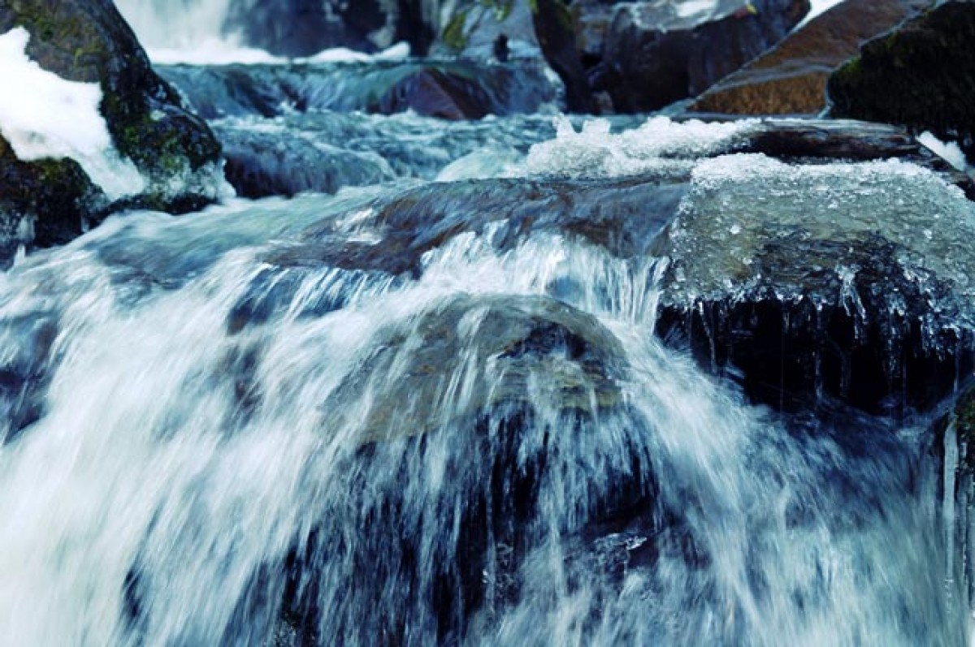

Slide 10
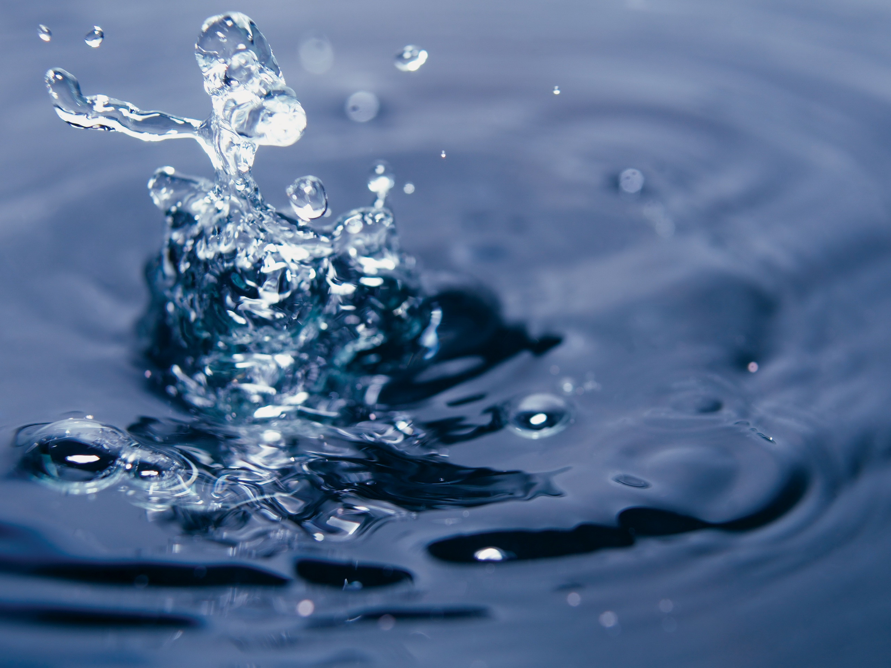

Slide 11
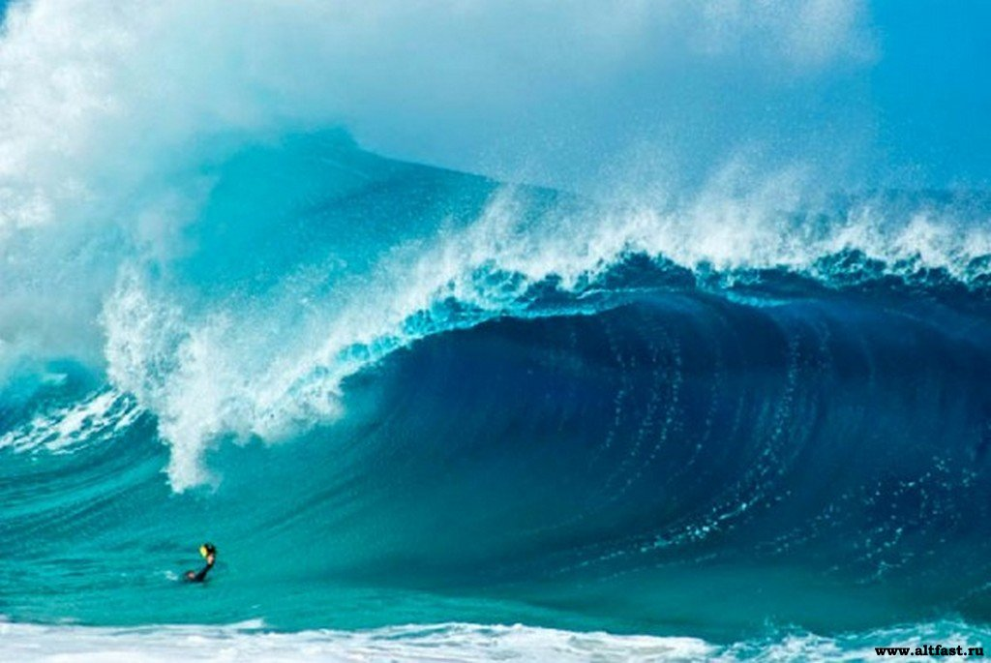

Slide 12
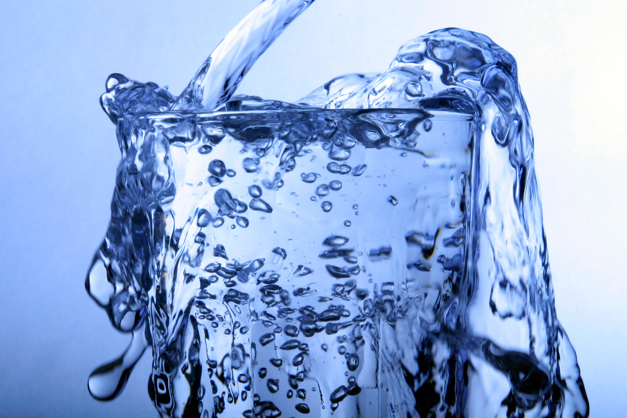

Slide 13
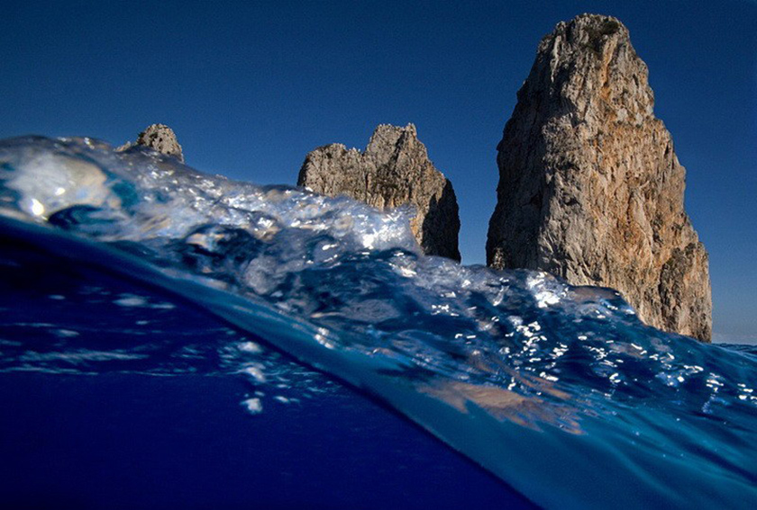

Slide 15
